Slide 1
Lecture 1 Introduction to Compilers

Slide 2
Outline
1 Preface
2 Language Process
3 The Evolution of Programming Languages
4 The Structure of a Compiler
5 Other Issues in Compiler Structure

Slide 3
Preface
“Principle of Compiler” is designed to introduce the student to the principles and practices of programming language implementation.
We cover lexical analysis, parsing theory (syntax analysis ), semantic analysis, runtime environments, and code generation.

Slide 4
Grading
The coursework will consist of programming projects, pencil-and-paper homework, and a final exam.
Assignments and attendance: 20%
Experiments: 20%
Final exam: 60%

Slide 5
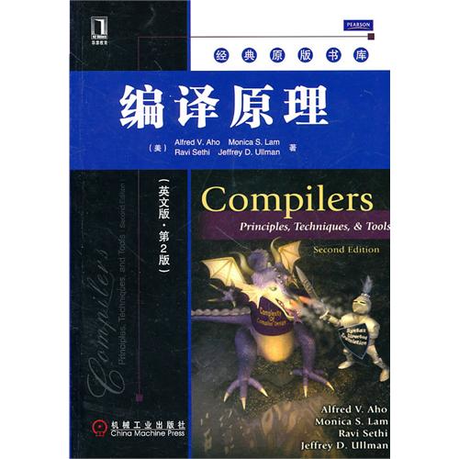
Reference Material
Textbook
Compilers: Principles, Techniques, and Tools
by Aho, Sethi, and Ullman—also known as "The Red Dragon Book"
CS164 in Berkeley and CS143 in Stanford

Slide 6
Why Study Compilers?
Learn how to build programming languages.
Learn how programming languages work.
Improve understanding of program behavior
Learn tradeoffs in language design.
Increase capacity of expression
Learn to build a large and reliable system
See many basic CS concepts at work
See theory come to life.

Slide 7
Outline
1 Preface
2 Language Process
3 The Evolution of Programming Languages
4 The Structure of a Compiler
5 Other Issues in Compiler Structure

Slide 8
Why Compiler
The development of programming language
Machine language (C7 06 0000 0002)
Assembly language (MOV x,2)
High-level language (x=2)
Computer can only execute the code written in the machine instructions of the computer. For high-level programs to be used, there must have a program to translate high-level programs to machine code

Slide 9
What is Compiler
Compilers are computer programs that translate one language to another
Source language: the input of a compiler, usually high-level language(such as C,C++)
Target language: the output of a compiler, usually object code for the target machine(such as machine code, assembly language)
Source Program
Target Program
Compiler
Input
Target Program
Output

Slide 10
Problems to address
How to describe language clearly for programmers, precisely for implementers?
How to implement description, and know you’re right?
Automatic conversion of description to implementation
Testing
How to save implementation effort?
Multiple languages to multiple targets: can we re-use effort?
How to make languages usable?
Handle errors reasonably
Detect questionable constructs
Compile quickly

Slide 11
Interpreter and Compiler
The same point: They are all language implementing system
Differences:
Interpreter executes the source program during translation
Compiler generates object code that is executed after translation completes
Interpreter
Source Program
Input
Output

Slide 12
Interpreter and Compiler
Interpreters run programs “as is”
Little or no preprocessing
Compilers do extensive preprocessing
Most implementations use compilers
New trend is hybrid: “Just-In-Time” compilation, interpretation + compilation
How does JAVA work?

Slide 13
Interpreter and Compiler
JAVA work

Slide 14
Just-In-Time
Source language
Compiler
Intermediate code
Virtual Machine
Output
Input
Mixed Compiler

Slide 15
Programs Related to Compilers
The process of high-level programming language

Slide 16
Source program
preprocessor
Source program
compiler
Assembly language program
assembler
Relocatable machine code
loader/linker
Relocatable object files
Target machine code

Slide 17
Outline
1 Preface
2 Language Process
3 The Evolution of Programming Languages
4 The Structure of a Compiler
5 Other Issues in Compiler Structure

Slide 18
A Short History of Compilers and Programming Languages
First, there was nothing.
Then, there was machine code.
Then, there were assembly languages.
Programming expensive; 50% of costs for machines went into programming.

Slide 19
History of High-Level Languages
Initially, programs “hard-wired” or entered electro-mechanically: Analytical Engine, Jacquard Loom, ENIAC, punched-card-handling machines
Programs encoded as numbers (machine language) stored as data: Manchester Mark I, EDSAC.
In 1952 Grace Hopper had an operational compiler. "Nobody believed that," she said. "I had a running compiler and nobody would touch it. They told me computers could only do arithmetic."
All programming done in assembly
Problem: Software costs exceeded hardware costs!
John Backus: “Speedcoding”
An interpreter
Ran 10-20 times slower than hand-written assembly
Notes:
1945年 冯· 诺依曼存储程序计算机
1948年 第一台可存储程序的数字计算机Manchester Mark I 问世
1949年 电子延迟存储自动计算机(EDSAC)
困难的浮点计算和下标寻址之障

Slide 20
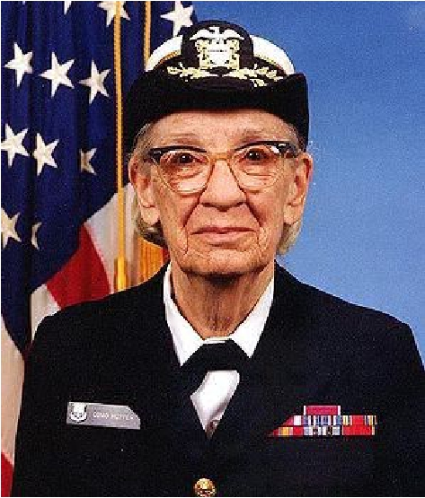
High-Level Languages
Rear Admiral Grace Hopper, inventor of A-0, COBOL, and the term “compiler.”
Image: http://upload.wikimedia.org/wikipedia/commons/thumb/5/55/Grace_Hopper.jpg/300px-Grace_Hopper.jpg

Slide 21
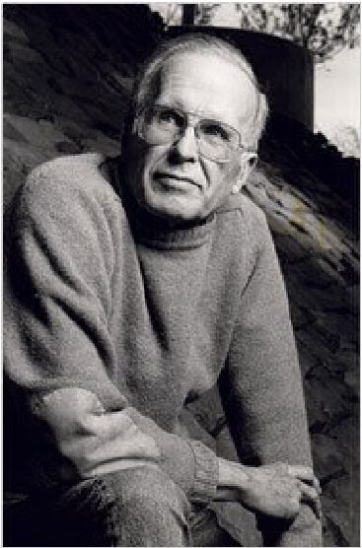
High-Level Languages
Image: http://upload.wikimedia.org/wikipedia/commons/thumb/5/55/Grace_Hopper.jpg/300px-Grace_Hopper.jpg

Slide 22
High-Level Languages
John Backus, team leader on FORTRAN.
http://www.nytimes.com/2007/03/20/business/20backus.html

Slide 23
FORTRAN I
1953 IBM develops the 701 , and 1954 the 704
John Backus
Idea: translate high-level code to assembly
Many thought this impossible
1954-7 FORTRAN I project
By 1958, >50% of all software is in FORTRAN
Cut development time dramatically
(2 wks to 2 hrs)

Slide 24
FORTRAN I
The first compiler
Produced code almost as good as hand-written
Huge impact on computer science
Led to an enormous body of theoretical work
Modern compilers preserve the outlines of FORTRAN I

Slide 25
After FORTRAN
LISP, late 1950s: dynamic, symbolic data structures.
Algol 60: Europe’s answer to FORTRAN: modern syntax, block structure, explicit declaration. Set standard for language description.
COBOL: late 1950’s. Business-oriented. Records.
Hopper's belief that programs should be written in a language that was close to English rather than in machine code or languages close to machine code (such as assembly language) was captured in the new business language, and COBOL would go on to be the most ubiquitous business language to date

Slide 26
The 60s Language Explosion
APL (arrays), SNOBOL (strings), FORMAC (formulae), and many more.
1967-68: Simula 67, first “object-oriented” language.
Algol 68: Combines FORTRANish numerical constructs, COBOLish records, pointers, all described in rigorous formalism. Remnants remain in C, but Algol68 deemed too complex.
1968: “Software Crisis” announced. Trend towards simpler languages: Algol W, Pascal, C

Slide 27
The 1970s
Emphasis on “methodology”: modular programming,, Modula family.
Mid 1970’s: Prolog. Declarative logic programming.
Mid 1970’s: ML (Metalanguage) type inference, pattern-driven programming.
Late 1970’s: DoD starts to develop Ada to consolidate >500 languages.

Slide 28
And on into the present
Complexity increases with C++.
Then decreases with Java.
Then increases again (C#).
Proliferation of little or specialized languages and scripting languages: HTML, PHP, Perl, Python, Ruby, …
Time Line

Slide 29
Outline
1 Preface
2 Language Process
3 The Evolution of Programming Languages
4 The Structure of a Compiler
5 Other Issues in Compiler Structure

Slide 30
How does a compiler work?

Slide 31
4Ω
3Ω
6Ω
6V

Slide 32
4Ω
3Ω
6Ω
6V

Slide 33
4Ω
3Ω
6Ω
6V

Slide 34
4Ω
3Ω
6Ω
6V

Slide 35
4Ω
3Ω
6Ω
6V

Slide 36
4Ω
3Ω
6Ω
6V

Slide 37
4Ω
3Ω
6Ω
6V

Slide 38
4Ω
3Ω
6Ω
6V
1
+
=2 Ω
1
3Ω
1
6 Ω

Slide 39
4Ω
2Ω
6V
1
+
=2 Ω
1
3 Ω
1
6 Ω

Slide 40
4Ω
2Ω
6V

Slide 41
4Ω
2Ω
6V
4 Ω + 2 Ω =6 Ω

Slide 42
6Ω
6V
4 Ω + 2 Ω =6 Ω

Slide 43
6Ω
6V

Slide 44
6Ω
6V
6V

Slide 45
6Ω
6V
Total Cost: $4.75
6V

Slide 46
6Ω
1.5V
1.5V
1.5V
1.5V

Slide 47
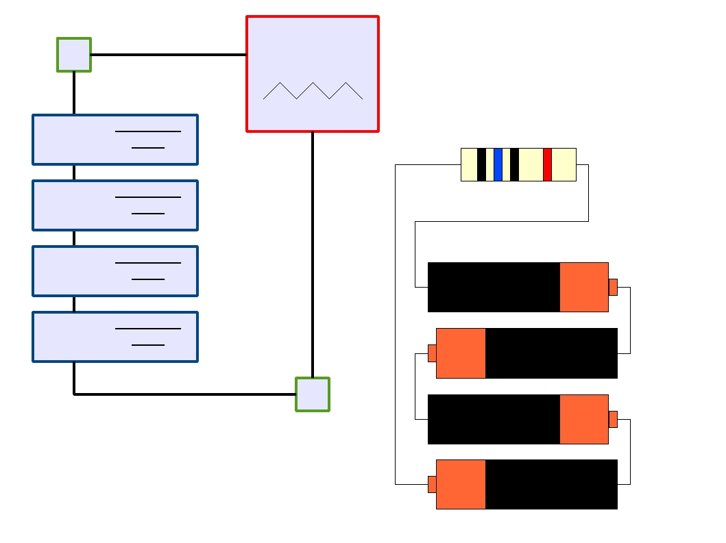
6Ω
1.5V
1.5V
1.5V
1.5V
AAA
AAA
AAA
AAA

Slide 48

6Ω
1.5V
1.5V
1.5V
1.5V
Total Cost: $1.00
AAA
AAA
AAA
AAA

Slide 49
From Description to Implementation
●
●
●
●
●
●
●
Lexical analysis (Scanning): Identify logical
pieces of the description.
Syntax analysis (Parsing): Identify how those
pieces relate to each other.
Semantic analysis: Identify the meaning of the
overall structure.
IR Generation: Design one possible structure.
IR Optimization: Simplify the intended structure.
Generation: Fabricate the structure.
Optimization: Improve the resulting structure.

Slide 50
The Structure of a Modern Compiler
Source
Code
Lexical Analysis
Syntax Analysis
Semantic Analysis
IR Generation
IR Optimization
Code Generation
The first 3, at least, can be understood by analogy to how humans comprehend language.
Optimization
Machine
Code

Slide 51
The Structure of a Modern Compiler
Source
Code
Lexical Analysis
Syntax Analysis
Semantic Analysis
IR Generation
IR Optimization
Code Generation
Front End
Optimization
Machine
Code

Slide 52
The Structure of a Modern Compiler
Source
Code
Lexical Analysis
Syntax Analysis
Semantic Analysis
IR Generation
IR Optimization
Code Generation
Back End
Optimization
Machine
Code

Slide 53
while (y < z) {
int x = a + b;
y += x;
}
Lexical Analysis
Syntax Analysis
Semantic Analysis
IR Generation
IR Optimization
Code Generation
Optimization

Slide 54
while (y < z) {
int x = a + b;
y += x;
}
Lexical Analysis
Syntax Analysis
Semantic Analysis
IR Generation
IR Optimization
Code Generation
Optimization

Slide 55
while (y < z) {
int x = a + b;
y += x;
}
T_While
T_LeftParen
Lexical Analysis
T_Identifier
T_Less
T_Identifier
T_RightParen
T_OpenBrace
T_Int
T_Identifier
T_Assign
T_Identifier
T_Plus
T_Identifier
T_Semicolon
T_Identifier
T_PlusAssign
T_Identifier
T_Semicolon
T_CloseBrace
y
z
x
a
b
y
x
Syntax Analysis
Semantic Analysis
IR Generation
Tokens
IR Optimization
Code Generation
Optimization

Slide 56
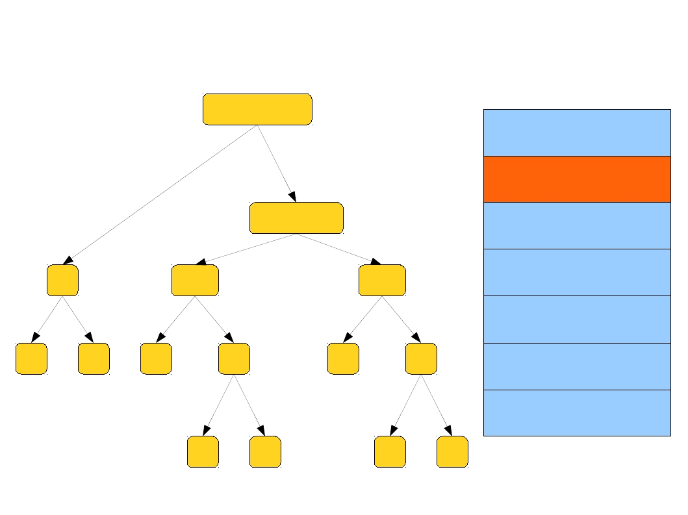
while (y < z) {
int x = a + b;
y += x;
}
Syntax Tree
While
Lexical Analysis
Syntax Analysis
Sequence
Semantic Analysis
IR Generation
<
=
=
IR Optimization
y
z
x
+
y
+
Code Generation
Optimization
a
b
y
x

Slide 57
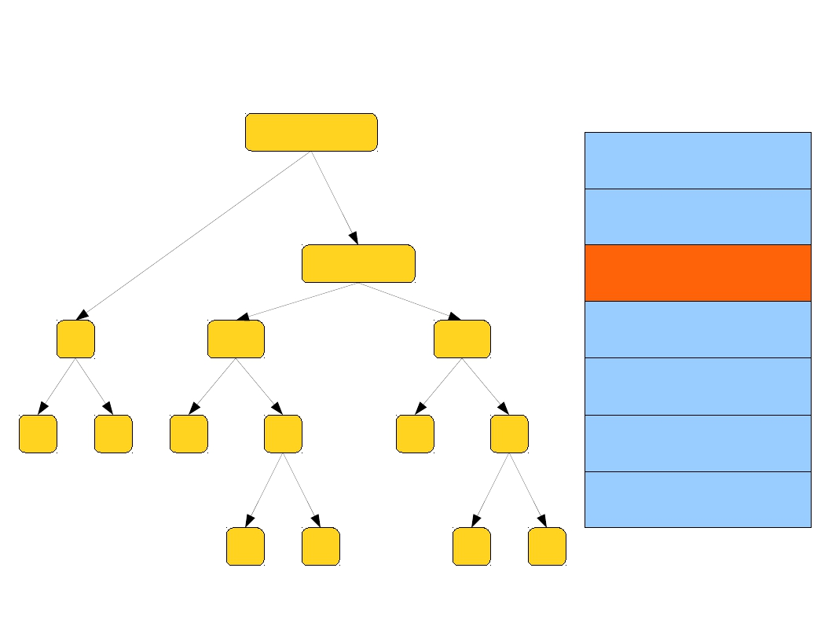
while (y < z) {
int x = a + b;
y += x;
}
Annotated Syntax Tree
While
void
Lexical Analysis
Syntax Analysis
Sequence
void
Semantic Analysis
int
IR Generation
<
bool
=
int
=
IR Optimization
y
int
z
int
x
int
+ int
y
int
+
int
Code Generation
Optimization
a
int
b
int
y
int
x
int

Slide 58
while (y < z) {
int x = a + b;
y += x;
}
Lexical Analysis
Loop: x = a + b
y = x + y
_t1 = y < z
if _t1 goto Loop
Syntax Analysis
Semantic Analysis
IR Generation
IR Optimization
Intermediate code
Code Generation
Optimization

Slide 59
while (y < z) {
int x = a + b;
y += x;
}
Lexical Analysis
x = a + b
Loop: y = x + y
_t1 = y < z
if _t1 goto Loop
Syntax Analysis
Semantic Analysis
IR Generation
IR Optimization
Code Generation
Optimization

Slide 60
while (y < z) {
int x = a + b;
y += x;
}
Lexical Analysis
add
Loop: add
slt
beq
$1,
$4,
$6,
$6,
$2, $3
$1, $4
$4, $5
loop
Syntax Analysis
Semantic Analysis
IR Generation
IR Optimization
Target code
Code Generation
Optimization

Slide 61
while (y < z) {
int x = a + b;
y += x;
}
add $1, $2, $3
Loop: add $4, $1, $4
blt $4, $5, loop
Lexical Analysis
Syntax Analysis
Semantic Analysis
IR Generation
IR Optimization
Code Generation
Optimization

Slide 62
Source code
Scanner
Tokens
Parser
Syntax Tree
Literal table
Semantic analyzer
Annotated Tree
Symbol table
Source code optimizer
Error handler
Intermediate code
Code generator
Auxiliary components that interact with some phases
Target code
Target code optimizer
Target code

Slide 63
Programming Assignments
Source
Code
Lexical Analysis
Syntax Analysis
Semantic Analysis
IR Generation
IR Optimization
Code Generation
Optimization
Machine
Code

Slide 64
Outline
1 Preface
2 Language Process
3 The Evolution of Programming Languages
4 The Structure of a Compiler
5 Other Issues in Compiler Structure

Slide 65
About Cross Compiler
Appendix for lecture1

Slide 66
什么是交叉编译？
在一个平台上生成另一个平台上的可执行代码。
这里需要注意的是所谓平台，实际上包含两个概念：体系结构（Architecture）、操作系统（Operating System）。同一个体系结构可以运行不同的操作系统；同样，同一个操作系统也可以在不同的体系结构上运行。
举例来说，我们常说的x86 Linux平台实际上是Intel x86体系结构和Linux for x86操作系统的统称；而x86 WinNT平台实际上是Intel x86体系结构和Windows NT for x86操作系统的简称。

Slide 67
“既然我们已经有了主机编译器，那为什么还要交叉编译呢？”
有时是因为目的平台上不允许或不能够安装我们所需要的编译器，而我们又需要这个编译器 的某些特征；有时是因为目的平台上的资源贫乏，无法运行我们所需要编译器；有时又是因为目的平台还没 有建立，连操作系统都没有，根本谈不上运行什么编译器。

Slide 68
“既然可以交叉编译，那还要主机编译干吗？”
交叉编译是不得已而为之！与主机编译相比，交叉编译受的限制更多，虽然在理论上我们可以做任何形式的交叉编 译，但事实上，由于受到专利、版权、技术的限制，并不总是能够进行交叉编译，尤其是在业余条件下！
举 例来说，我们至今无法生成惠普公司专有的som格式的可执行文件，因此我们根本无法做目的平台为 HPPA-HPUX的交叉编译。

Slide 69
iPhone的SDK只能在OSX上运行，这也是没办法的事情，因为Xcode从来没有被移植到OSX之外的地方去，就好像Visual C++从来都没有过*nix版本，如果有人要写windows CE的应用，多半也得装个windows
但是在Linux/windows上有人做了基于GNU Objective-C的交叉编译环境，有不少在iPhone SDK发布之前的软件就是这么做出来的。
1、OS/X并不是只能用object-c开发程序，gcc编译器中支持的语言在OS/x下都可以，就不用说C了。
2、Xcode是OS/X下的集成开发环境，和Windows下的VS类似。
3、OS/X操作系统的底层内核是开源的（ Darwin是苹果机的操作系统OS X的基础“核心”，其中结合了两大著名的程序，Mach 内核和Berkeley BSD4.4 ）

Slide 70
已存在A平台上的L语言编译器，要求生产一个B平台上的L语言编译器。如何做？
to?
L |  | A
 | A
L |  | B
 | B
L |  | B
 | L
L |  | B
 | A
L |  | A
 | A
L |  | B
 | L
L |  | B
 | B
L |  | B
 | A

Slide 71
Next Time...
Source
Code
Lexical Analysis
Syntax Analysis
Semantic Analysis
IR Generation
IR Optimization
Code Generation
Optimization
Machine
Code

